Slide 1
EURO 2024 Prediction
FROEHLICH Marc
MIRANDA André
PETIT-DANGEON Jeanne

Slide 2
Creating a football predictor for EURO 2024 :
Using historical football data
Using a supervised learning model that can predict match outcomes (win or loss/draw)

Slide 3
Summary
Data treatment
Model
Predictions

Slide 4
Data Collection
Data from kaggle.com
Source : “International football results from 1872 to 2023” (By Matt Jürisoo)
3 different databases :
results.csv
goalscorers.csv
shootouts.csv (not used for the model)

Slide 5
Data Collection
results.csv
45 100 observations
Football matches and results from 30/11/1872 until 23/10/2023
9 variables
Date
home_team
away_team
home_score
away_score
tournament
country
city
neutral

Slide 6
Data Collection
goalscorers.csv
41 113 Observations
Football matches and scorers from 02/07/1916 until 23/10/2023
8 variables :
Date
home_team
away_team
team
scorer
minute
own_goal
penalty

Slide 7
Data Preprocessing:
Cleaning, preprocessing, and preparing the data for modeling
Handling missing values, encoding categorical variables, and normalizing or scaling numerical features
Create a target variable that represents the match outcomes (e.g., “win” or “loss”).

Slide 8
Data Preprocessing:
Filter from 2018 to keep the data as updated as possible
Using all countries in the dataset to train the model
Predictions done only for countries in the Union des Associations Européennes de Football (UEFA) Euro 2024 candidates
Target variable : win
Assembling draw and defeat VS wins

Slide 9
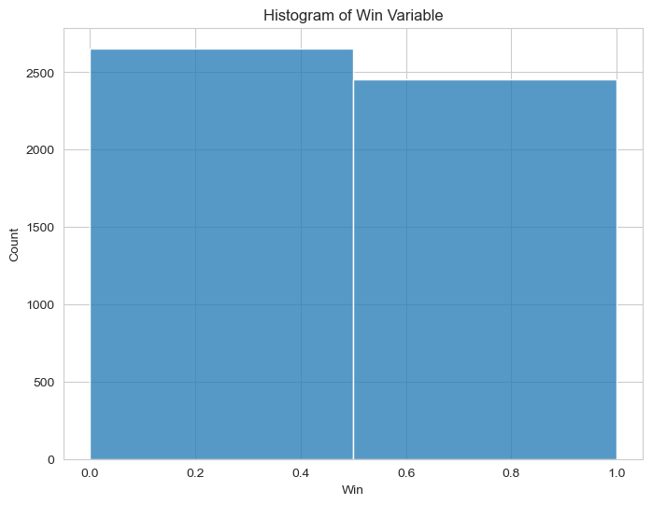

Slide 10
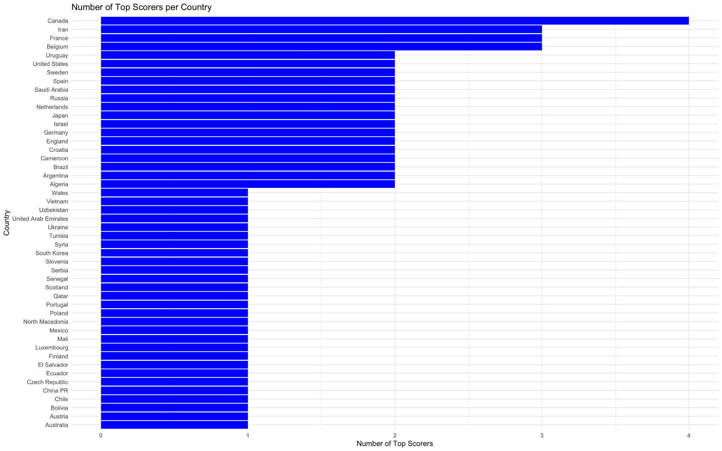

Slide 11
Creating variables useful to our predictions
Goal difference (difference between all the goals scored and conceded)
Number of clean sheets for each country
Points per game by country
Top scorer per country (keeping the 5% best, filtering out own goals and keeping penalties)

Slide 12
Feature Engineering
Variables for regression
Team quality
PPG
Goal Difference
Team attributes
Clean sheets
Player qualities
NB of top Goalscorers

Slide 13
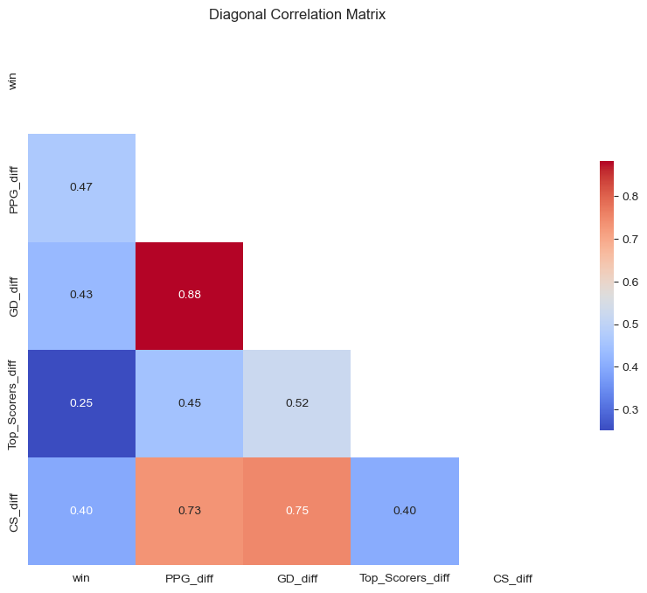
Data analysis

Slide 14
Data Splitting
80% of the data for training
20% of the data for testing

Slide 15
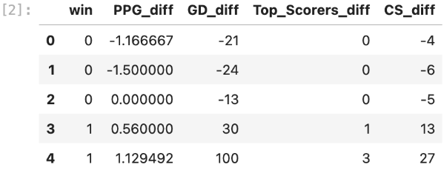
Model Training
The data frame used for training is a modified version of the original “results.csv” database.
It only features the explanatory variable and its regressors :
5 109 observations of 5 variables

Slide 16
Model Selection
Test accuracy to determine the best model
Candidates :
KNN
Decision Trees
Random Forest
Logistic Regression

Slide 17
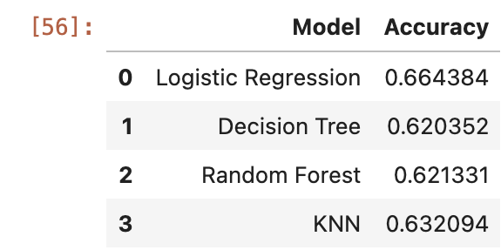
Model Selection

Slide 18
Model Selection
Logistic model
win = PPG_diff + GD_diff + Top_Scorers_diff + CS_diff

Slide 19
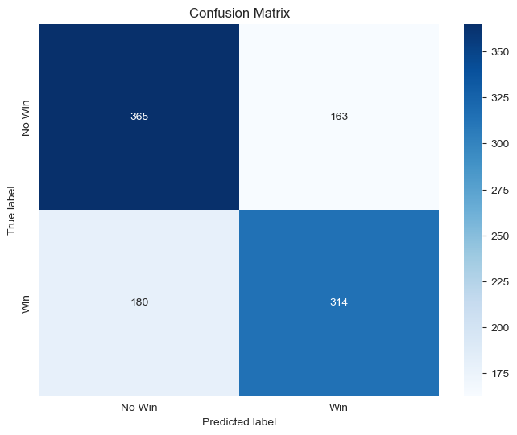
Model Selection
Logistic model

Slide 20
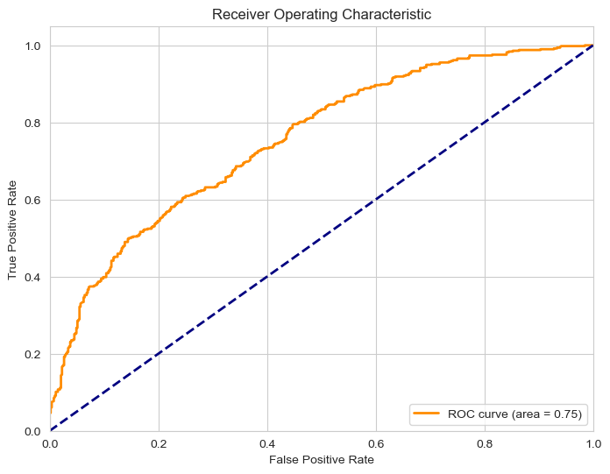
Model Selection
Logistic model

Slide 21
Accuracy Improvement
Outliers
Hyperparameter tuning
L1 and L2 yield the same results
Model doesn’t reach 70% test accuracy. Why?
Regressor choice
No H2H indicators
Randomness of football

Slide 22
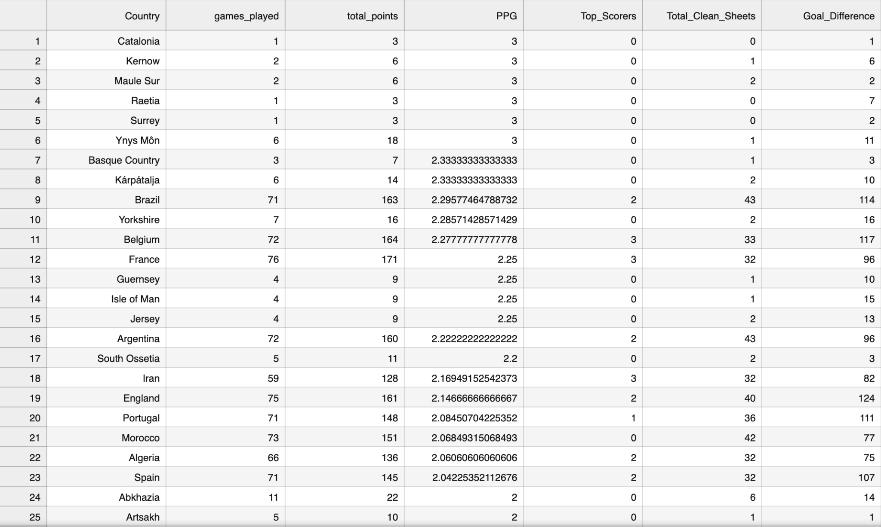
Prediction and Deployment
Data frame for predictions
265 observations
7 variables
merged with the training table for predictions

Slide 23

Tournament Simulation
https://euro2024-foot.net/uefa/simulation-pronostics-excel

Slide 24
Group Phase
GROUP A :
1) Belgium 9 points
2) Italy 6 points
3) Germany 3 points
4) Wales 0 points
GROUPE B :
1) Portugal 9 points
2) Finland 6 points
3) Scotland 3 points
4) Slovenia 0 point
GROUPE C :
1) France 9 points
2) England 6 points
3) Austria 3 points
4) Poland 0 point
GROUP D :
1) Croatia 9 points
2) Turkey 6 points
3) Switzerland 3 points
4) Czech Republic 0 point
GROUP E
1) Netherlands 9 points
2) Spain 6 points
3) Romania 3 points
4) Albania 0 point
GROUP F
1) Denmark 9 points
2) Serbia 6 points
3) Hungary 3 points
4) Iceland 0 point

Slide 25
Round of 8
Italy - Finland
Belgium - England
France - Switzerland
Portugal - Germany
Turkey - Spain
Denmark - Austria
Croatia - Serbia
Netherland - Scotland

Slide 26
Quarter-final
Spain- Denmark
France - Italy
Portugal - England
Serbia - Netherland

Slide 27
Semi-final
England - Denmark
Netherlands - France

Slide 28
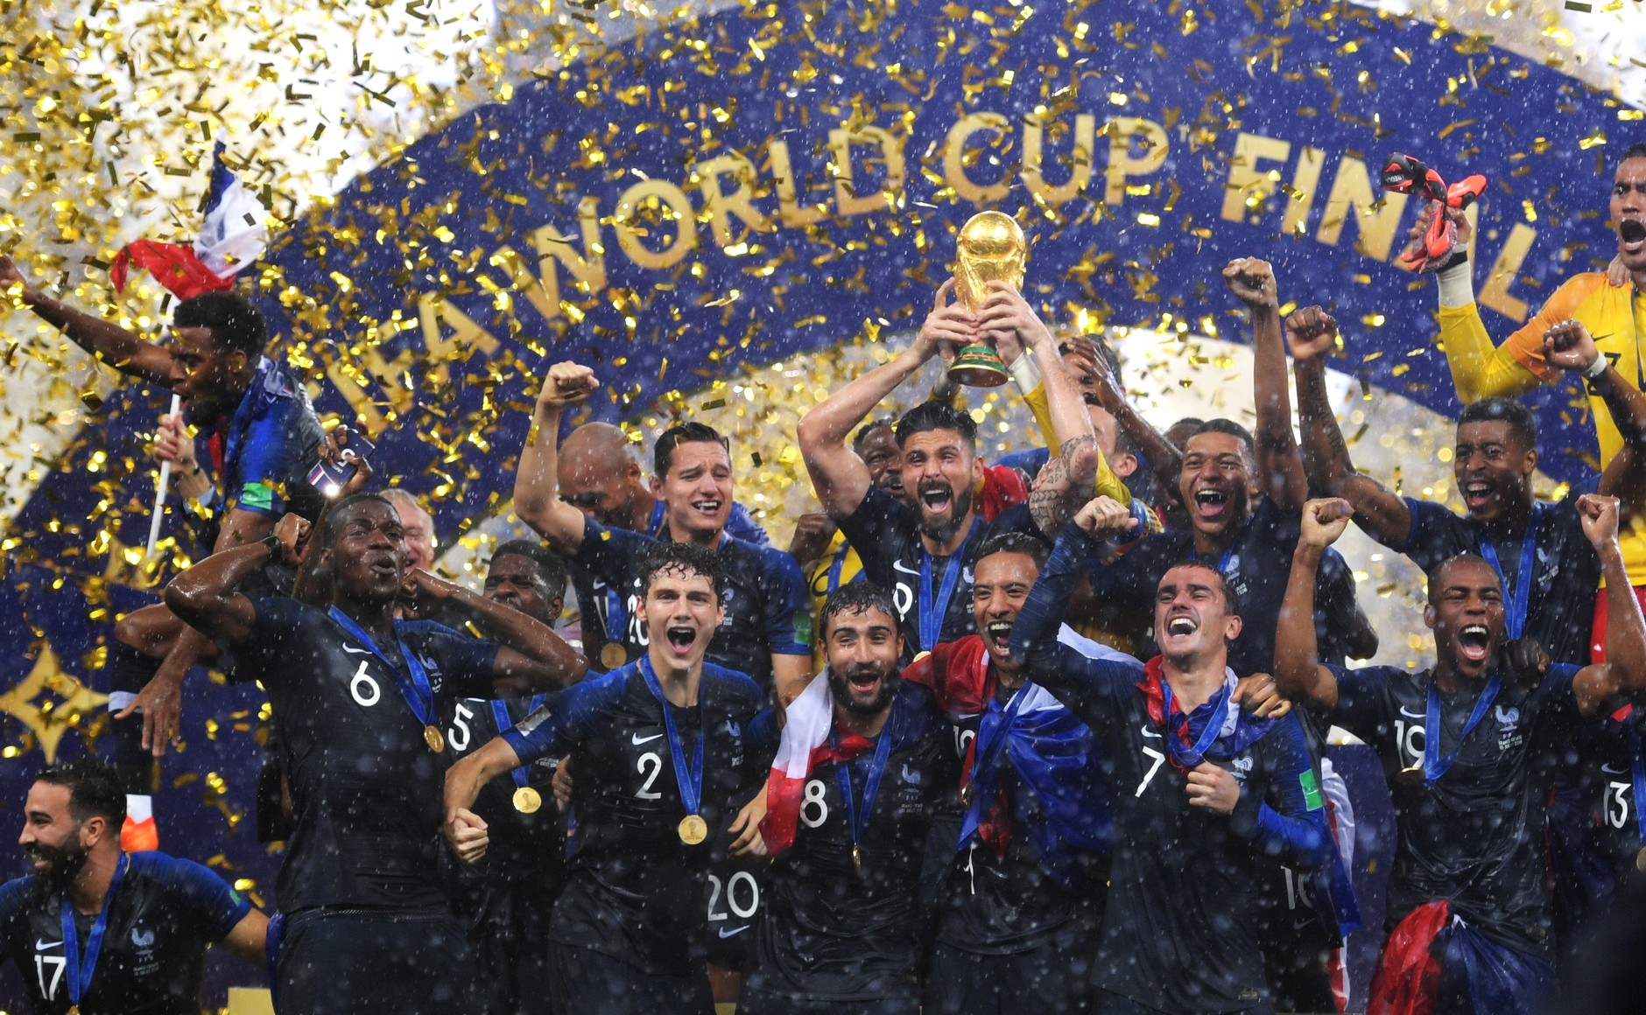
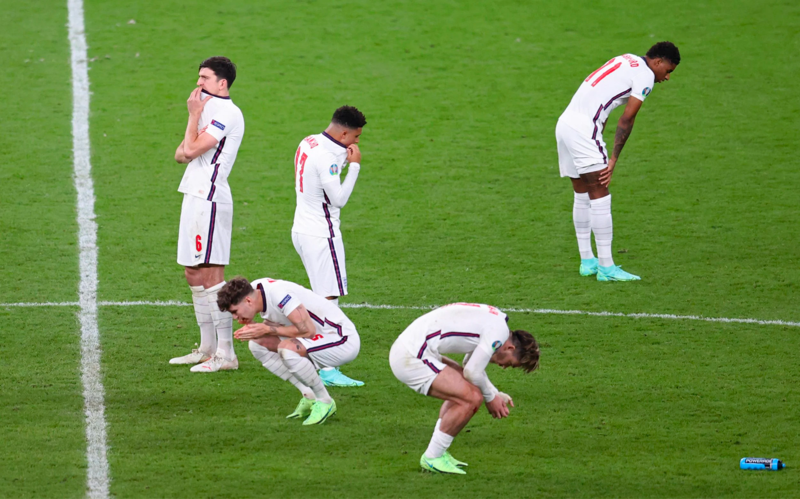
Final
Winner : France
England-France

Slide 29
Thank you for your attention !

